Slide 1
Cab Service

Slide 2
Capstone Project – Cab Booking System (MERN Stack + AI Enhancements)
Project Repository:
https://github.com/Kaleakash/car_booking_mern_stack_with_AI_tools_Project.git

Slide 3
Project Overview
- A MERN stack-based real-time Cab Booking System
- Features enhanced using Generative AI tools
- Fully functional frontend, backend, and payment integration
- GitHub repository provided for virtual lab deployment

Slide 4
Technology Stack
- Frontend: React.js
- Backend: Node.js + Express.js
- Database: MongoDB
- Version Control: Git + GitHub
- AI Tools: Uizard, GitHub Copilot, ChatGPT, TestRigor
- Payment Gateway: Stripe (Test Mode)

Slide 5
Project Setup Instructions
**Backend:**
- Clone project from GitHub
- Update db.js with MongoDB URL
- Run: npm install --force
- Start backend: npm start
**Frontend:**
- Navigate to frontend folder
- Run: npm install
- Start frontend: npm start

Slide 6
Project File Structure
- db.js: MongoDB connection config
- models/: Schema definitions
- routes/: API endpoints
- server.js: Main entry file
- frontend/: React application

Slide 7
User Journey
1. User Registration/Login
2. Dashboard Access
3. Admin: Add New Cars
4. User: Select Pickup/Drop Date
5. Choose Driver → Proceed to Payment
6. Payment (Stripe Test Mode)
7. View Booking Confirmation

Slide 8
Stripe Payment Integration
- Fake Card: 4242 4242 4242 4242
- Expiry: 12/28, CVV: 123
- Booking details confirmed after test payment
- Uses Stripe's test environment

Slide 9
Adding Gen AI UI via Uizard
1. Capture screenshot of React login page (.png/.jpg)
2. Go to https://uizard.io
3. Start new project → Upload Screenshot
4. Use Auto Designer to enhance UI

Slide 10
AI-Assisted Coding
Using GitHub Copilot & ChatGPT:
- Auto-generate component logic
- Example: getCabAvailability = async () => {}
- Use prompts like:
“Generate Mongoose schema for car booking”
“React + Stripe payment component”

Slide 11
AI-Powered Testing using TestRigor
1. Visit: https://testrigor.com
2. Sign Up → Confirm Email
3. Connect local/cloud URL
4. Use Natural Language test script:
- “Login as user…”
- “Search for cabs…”
- “Make payment with test card…”

Slide 12
Sample Natural Language Test Case
Go to "http://localhost:3000"
Enter "steven@gmail.com" into "Email"
Enter "steven@123" into "Password"
Click "Login"
Click "Book a Cab"
Enter "Mumbai" into "Pickup Location"
Enter "Pune" into "Drop Location"
Click "Search"
Click "Select" on first car
Click "Proceed to Payment"
Enter Card: "4242 4242 4242 4242", Expiry: "12/28", CVV: "123"
Click "Pay"
Verify "Booking Confirmed"

Slide 13
AI Tools Summary
🛠 Tool | 🔍 Purpose
GitHub Copilot | Auto-suggest code & logic
ChatGPT | Code generation & debugging
Uizard | UI design improvement from image
TestRigor | Natural language test creation

Slide 14
This project present in git repository in below URL
https://github.com/Kaleakash/car_booking_mern_stack_with_AI_tools_Project.git
Plz login to virtual lab and clone this project in virtual lab using command as
git clone https://github.com/Kaleakash/car_booking_mern_stack_with_AI_tools_Project.git

Slide 15
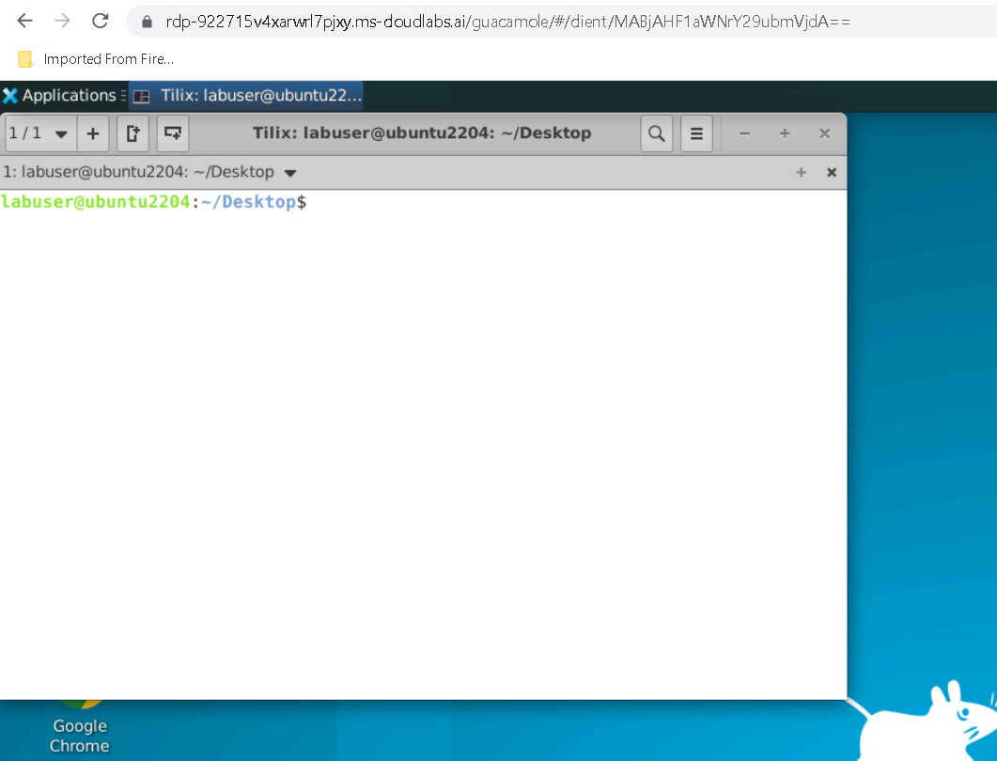

Slide 16
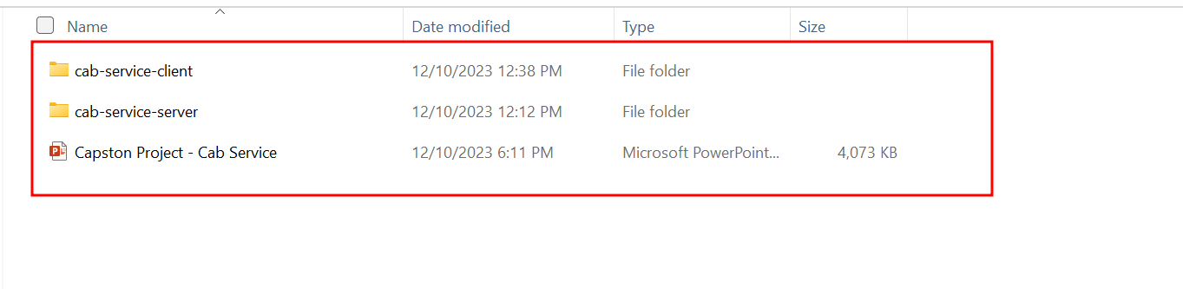
This is the project structure once you download in VM Machine

Slide 17
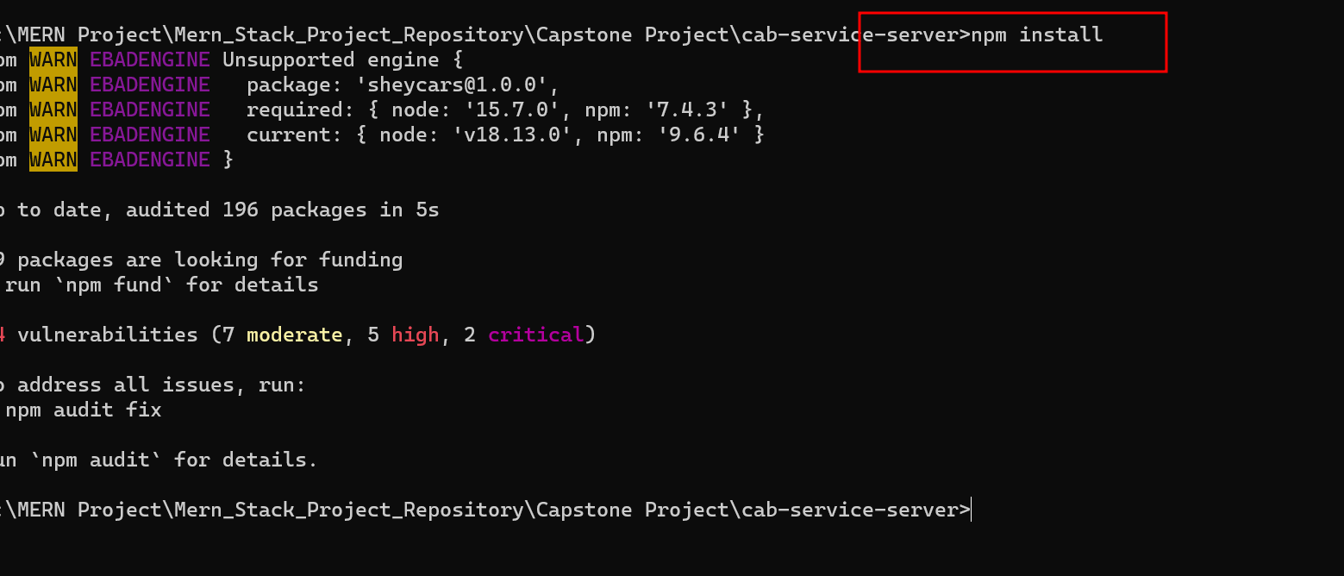
Open the terminal or command prompt inside a server folder and install server dependencies using below command

Slide 18
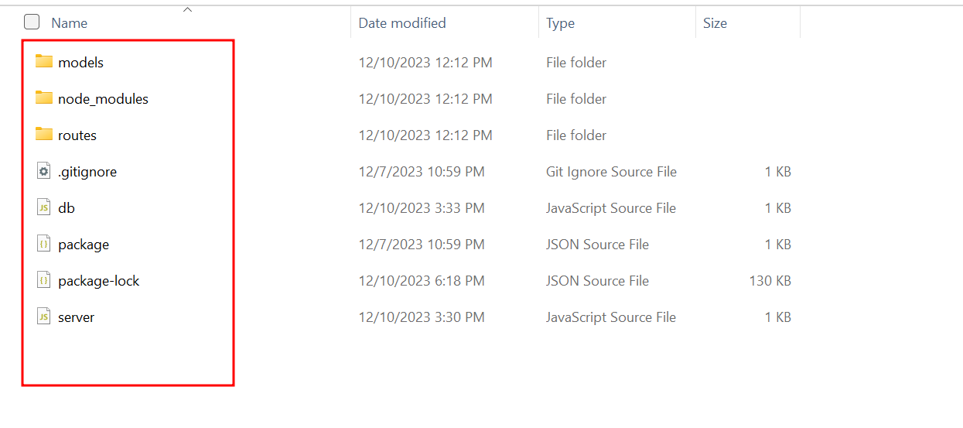
Project structure

Slide 19
Project structure explanation
In db.js file we can see the database connection details. If we use local machine database then ip address must be local host or 127.0.0.1 with port number 27017. database name is infer_car_db.

Slide 20
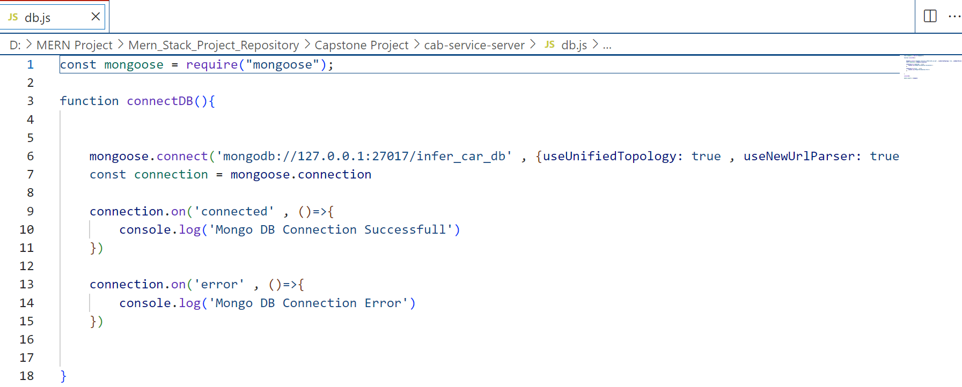

Slide 21
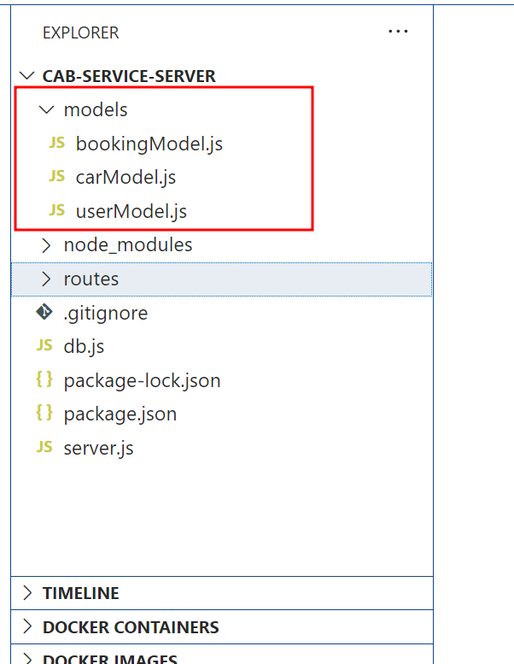
Model file: this file contains the structure of collection with schema definition

Slide 22
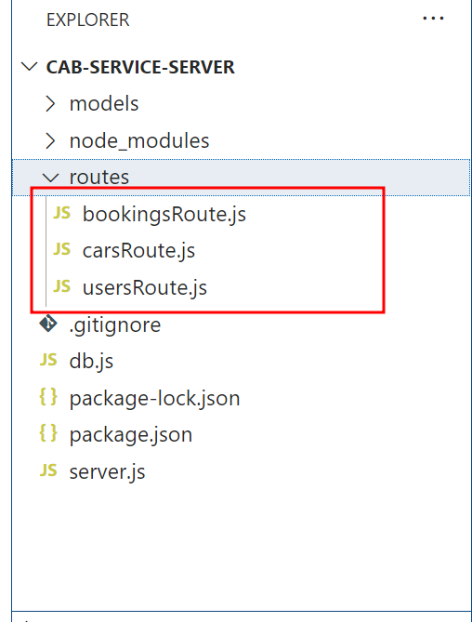
routes file: this file contains the structure of collection with schema definition.

Slide 23
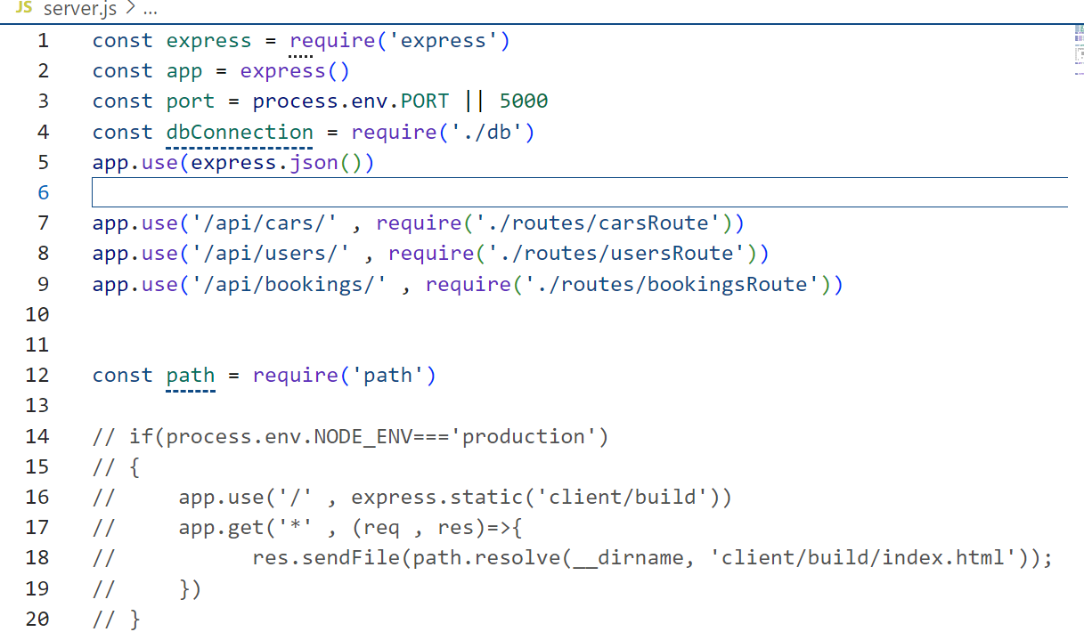
server.js file: this file contains the entry of the program with port number.

Slide 24
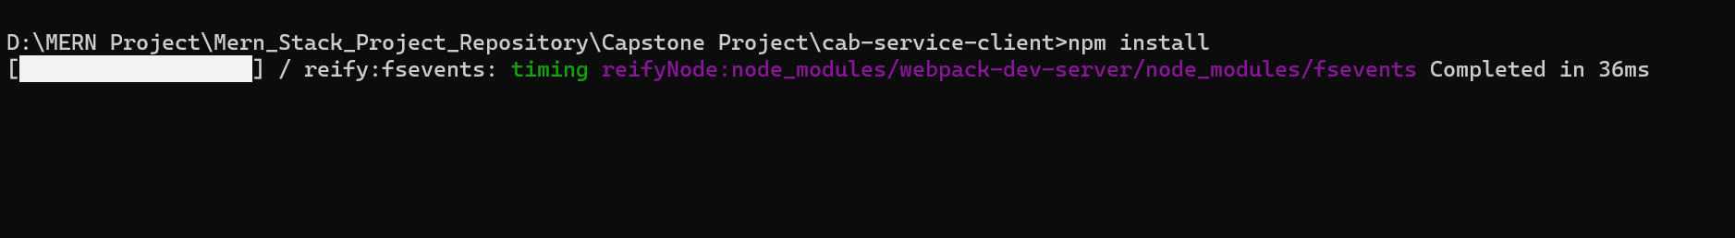
Now move inside a frontend folder
Then run the command as npm install --force to install all required dependencies.

Slide 25
Duppy secret key for payment
sk_test_51IYnC0SIR2AbPxU0EiMx1fTwzbZXLbkaOcbc2cXx49528d9TGkQVjUINJfUDAnQMVaBFfBDP5xtcHCkZG1n1V3E800U7qXFmGf

Slide 26
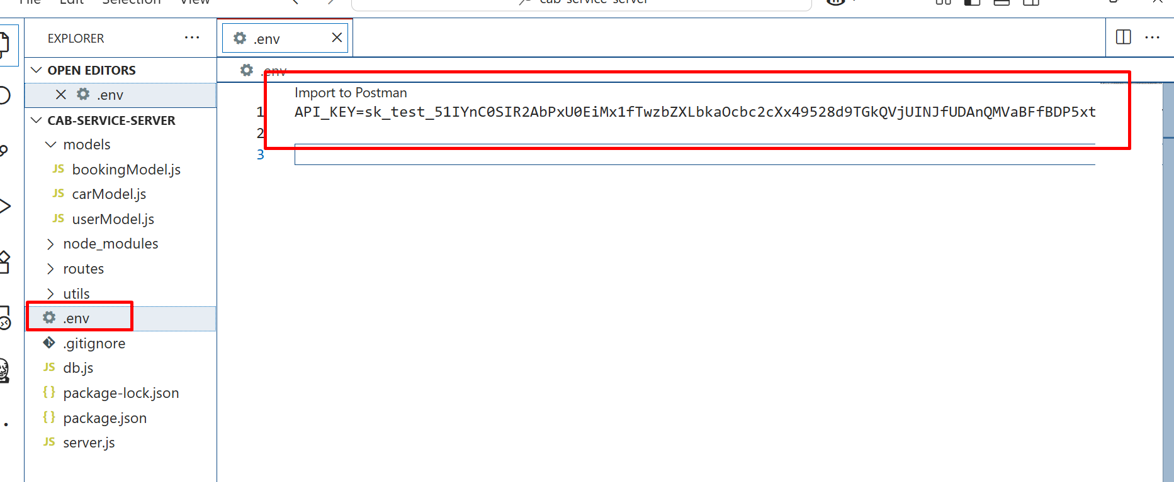
Please add dummy secret key
Open .evn file
add the secret key. Which help to do duppy payment.

Slide 27
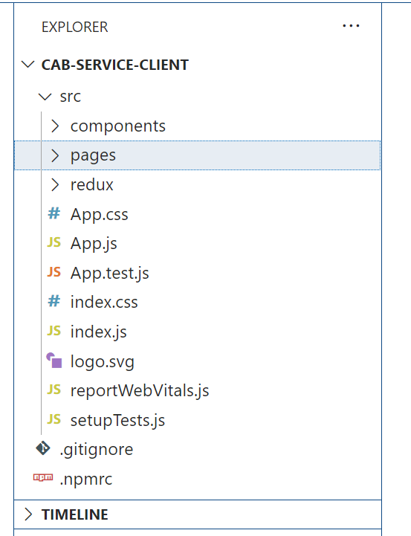
Front – react js project

Slide 28
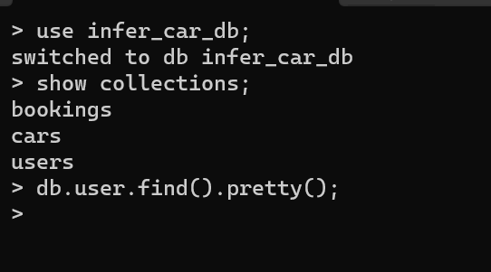
Database is mongo db
open the mongo db terminal

Slide 29
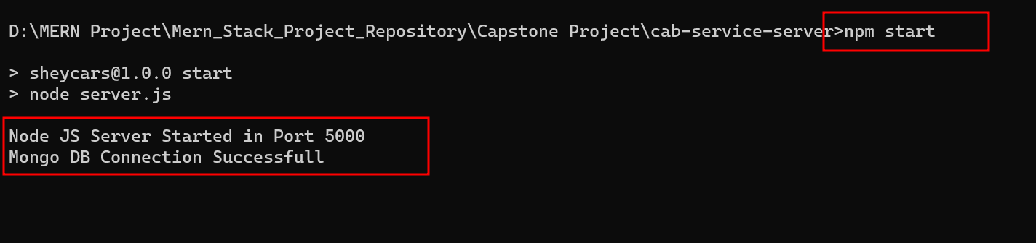
Now run the backend technology
Using the command as
npm start

Slide 30
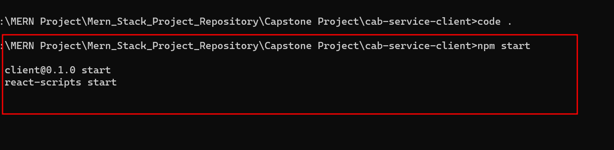
Now run the frontend technology
npm start

Slide 31
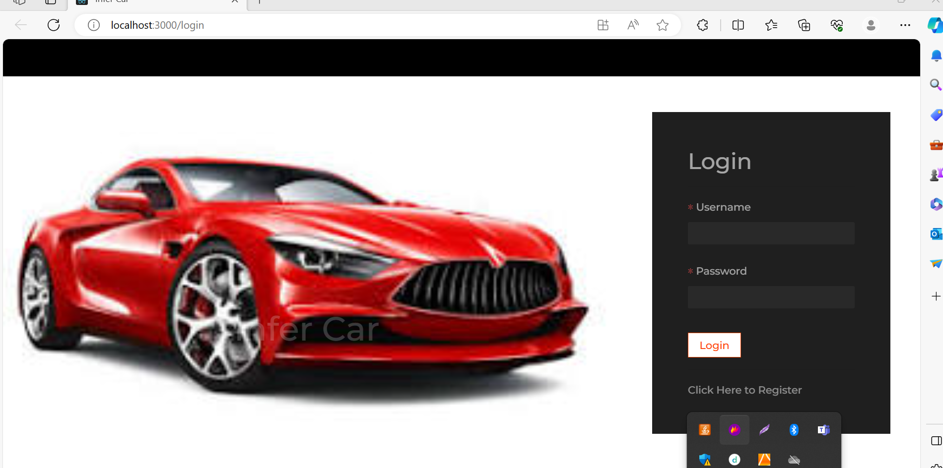
Open the browser and write the URL as http://localhost:3000/login.
Then you can see first page of the react js application

Slide 32
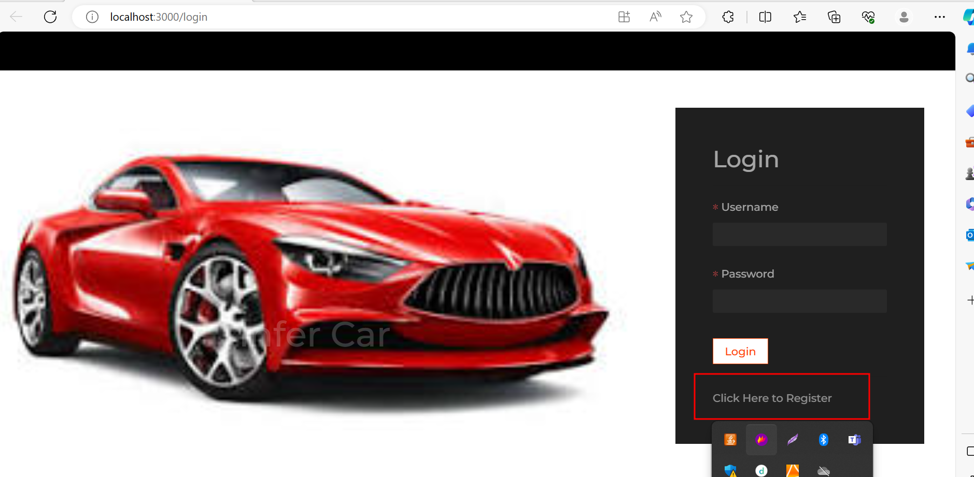
Now you do registration

Slide 33
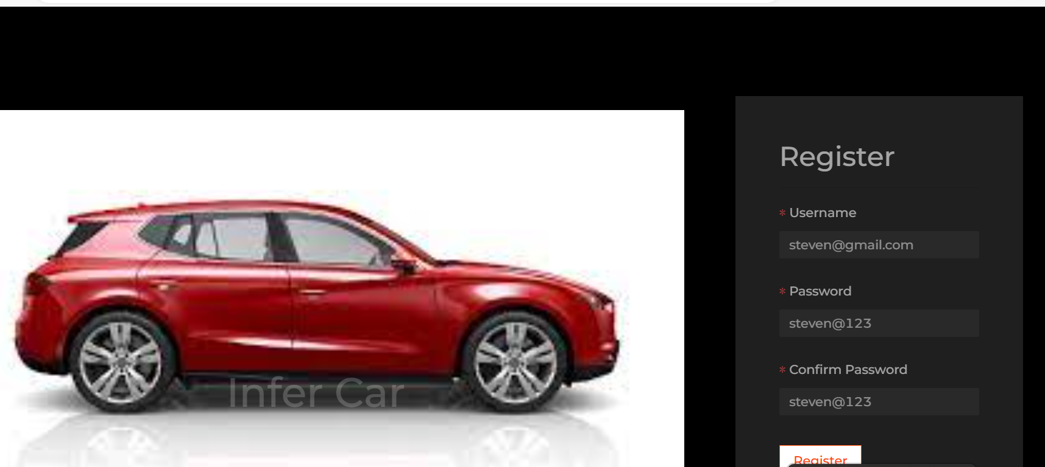
In Registration page you can provide the username and password details as below

Slide 34
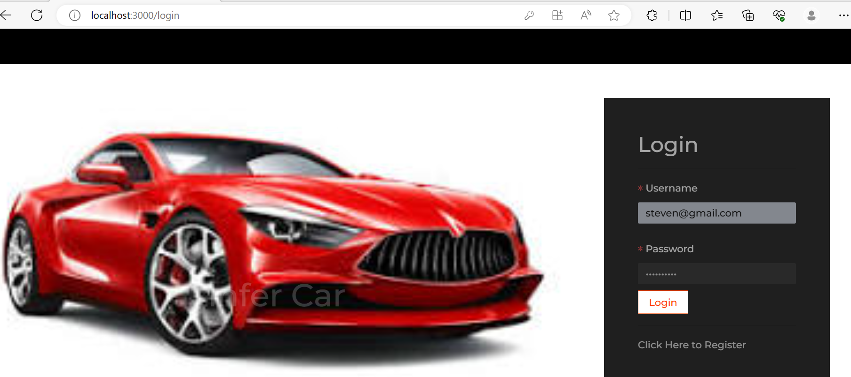
After registration you can do the login

Slide 35
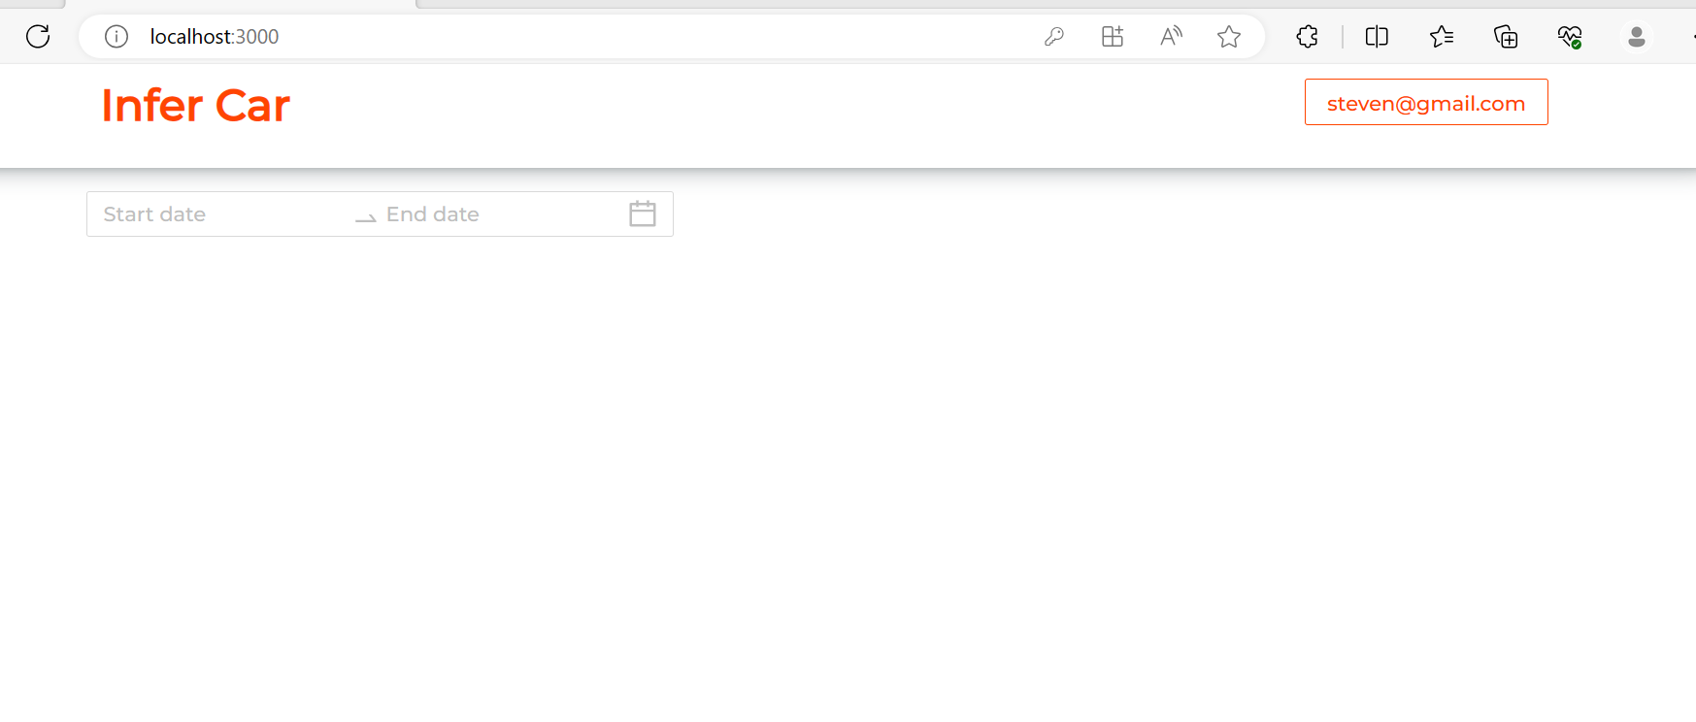
Dashboard
If you do login successfully you can see the dashboard of the application

Slide 36
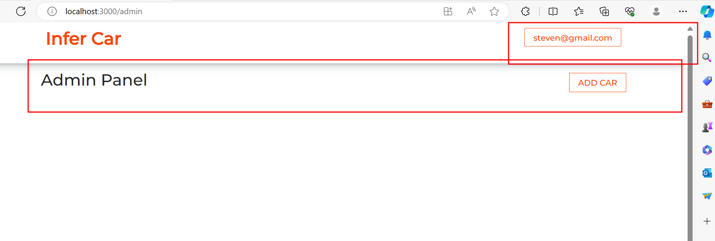
Using admin panel you can add the new cabs.

Slide 37
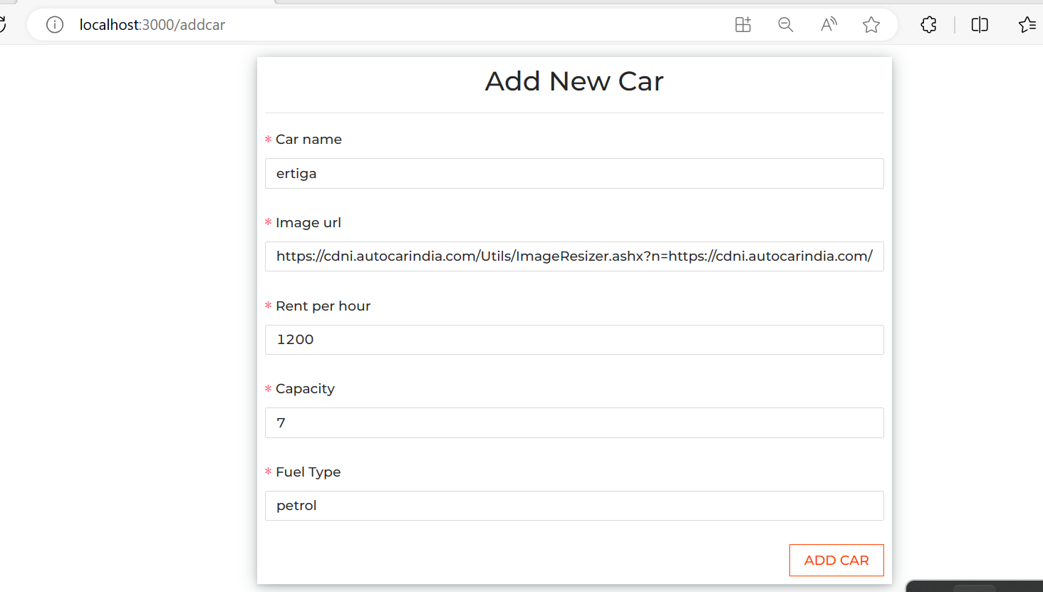
Add the car

Slide 38
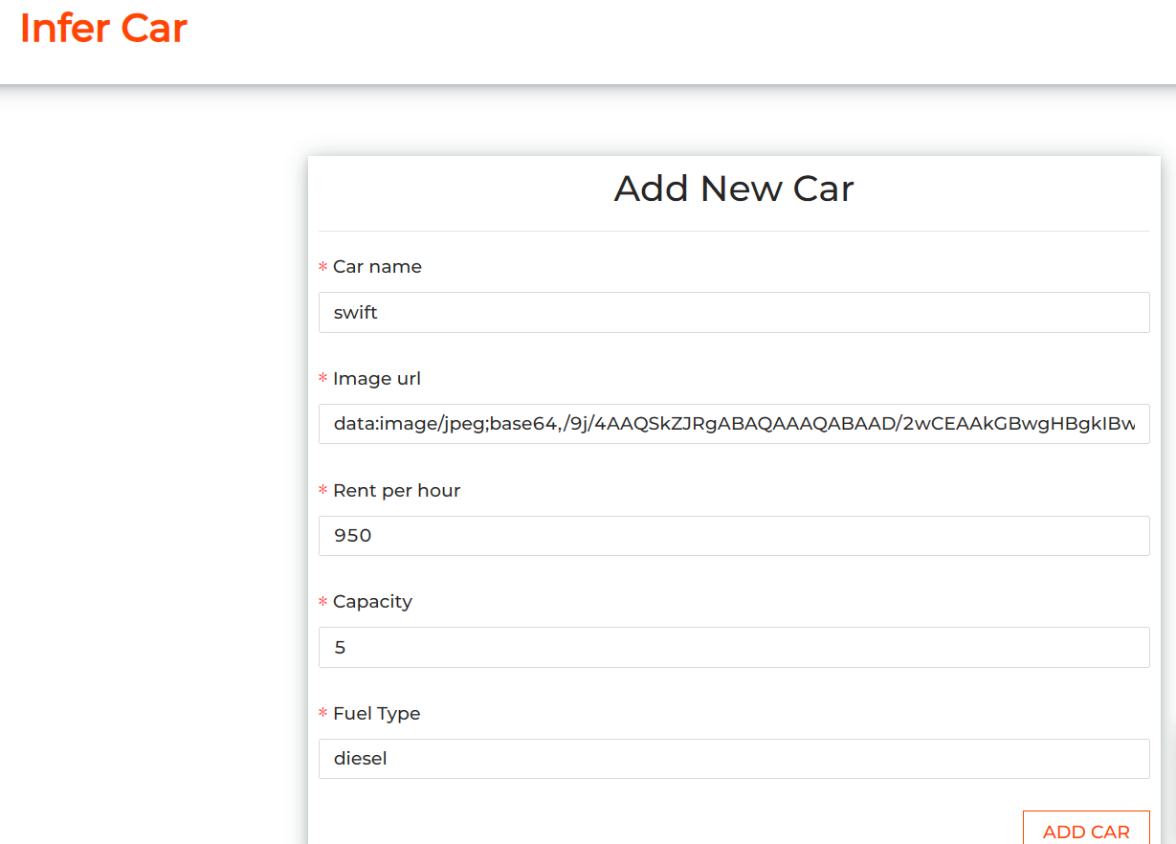
Add the car

Slide 39
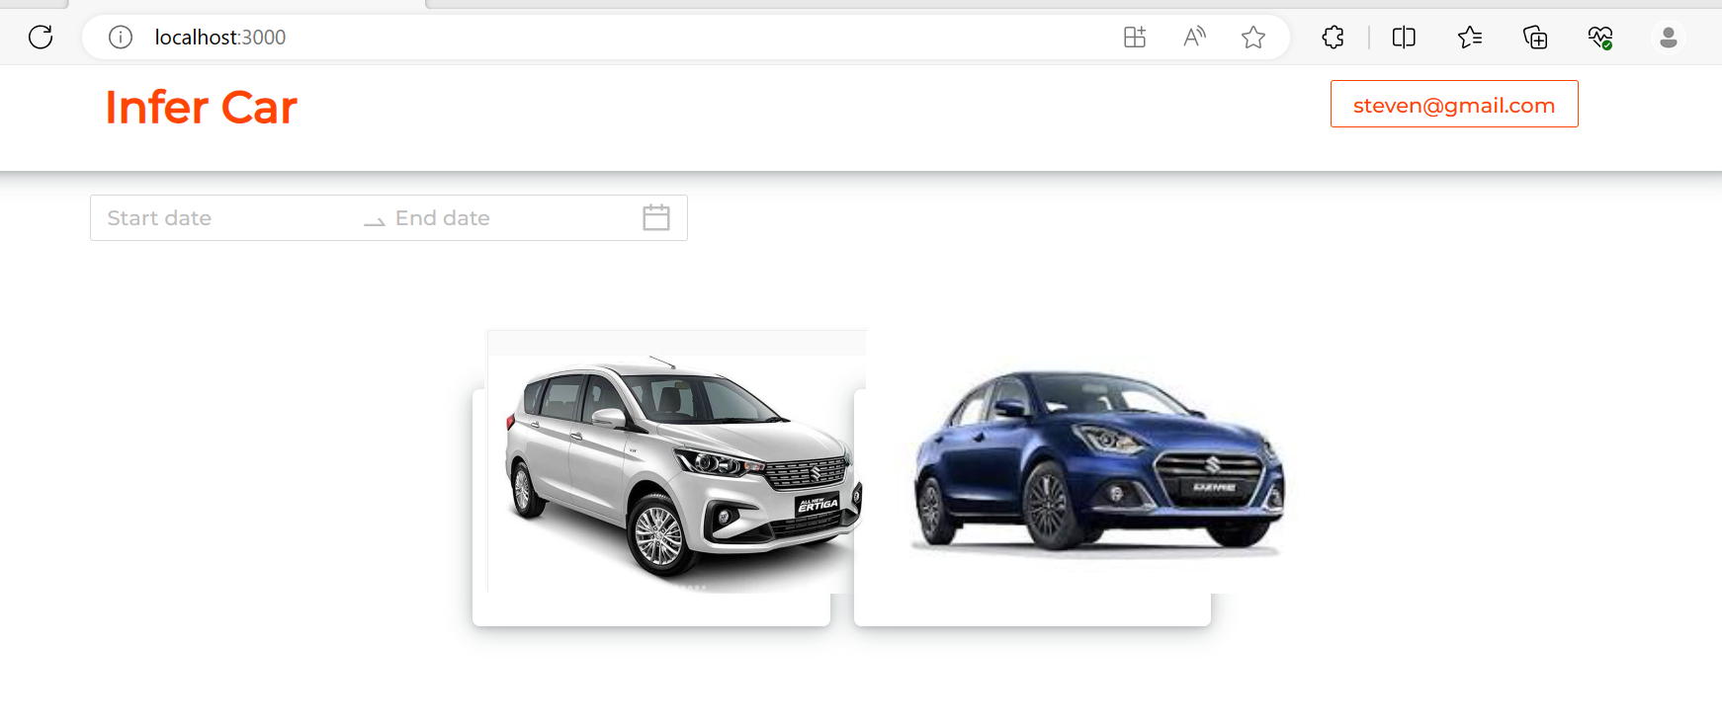
After added cars

Slide 40
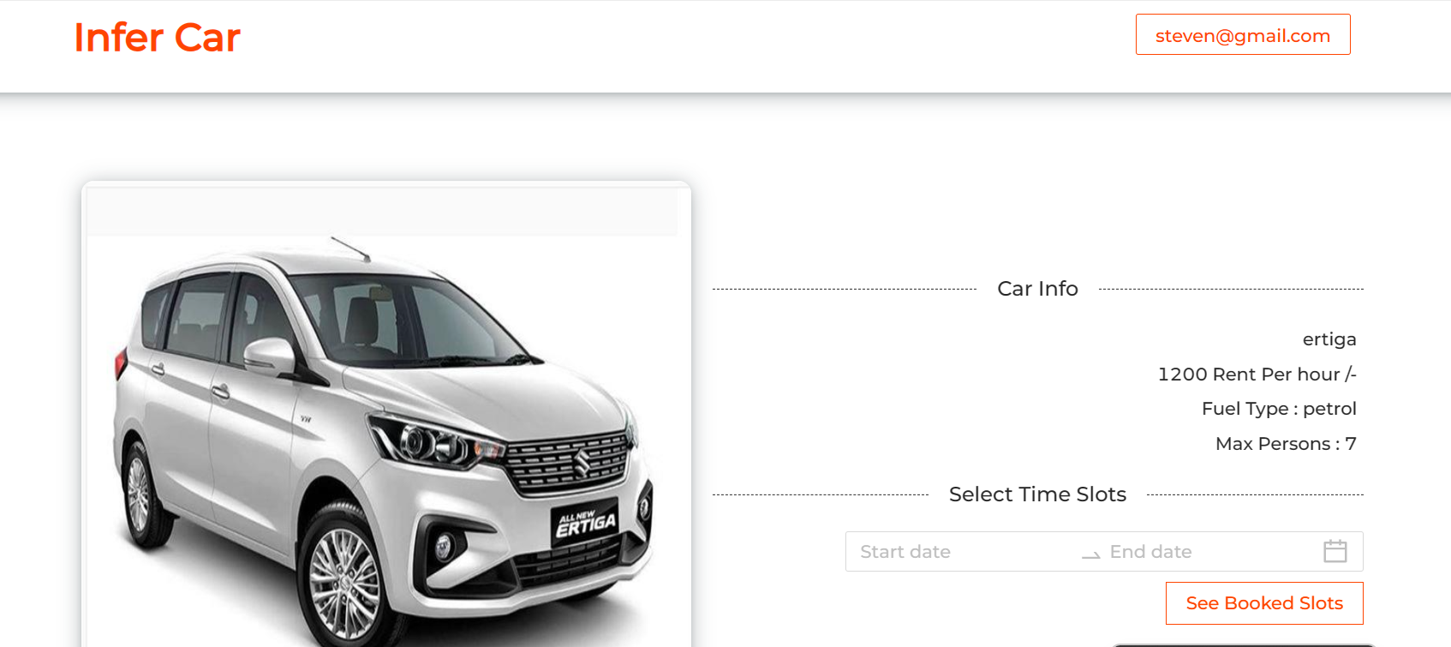
Now you can book the cab

Slide 41
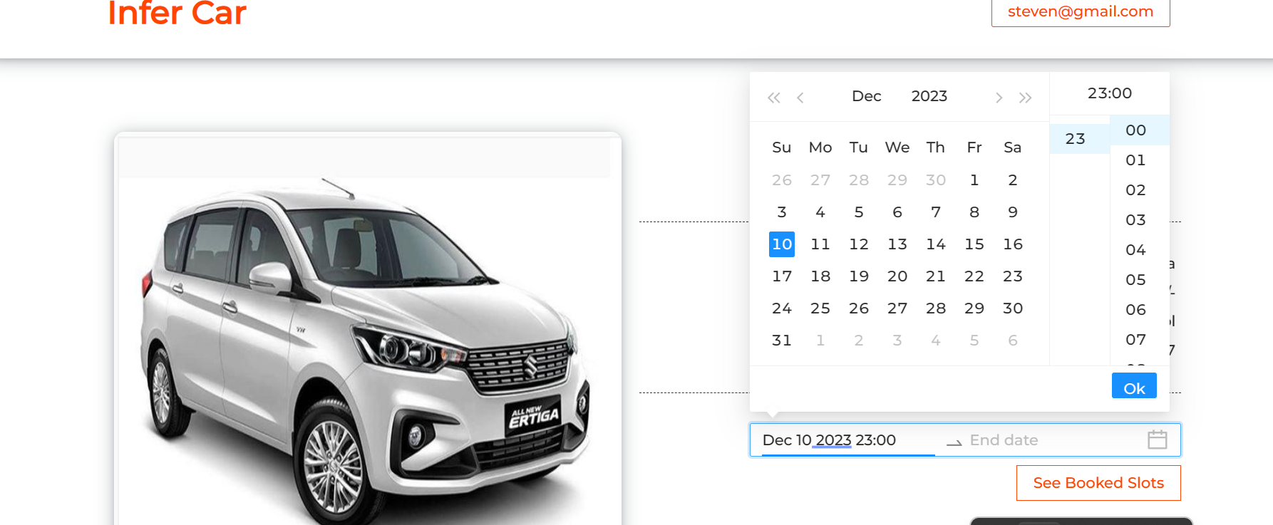
Please provide start date

Slide 42
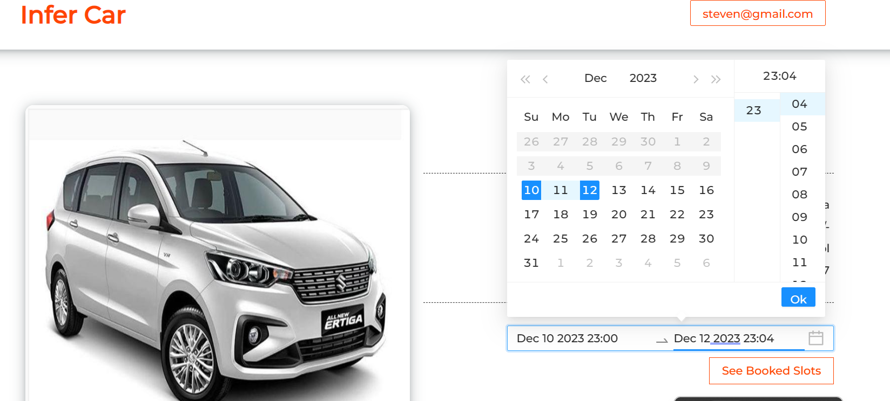
Please provide end date

Slide 43
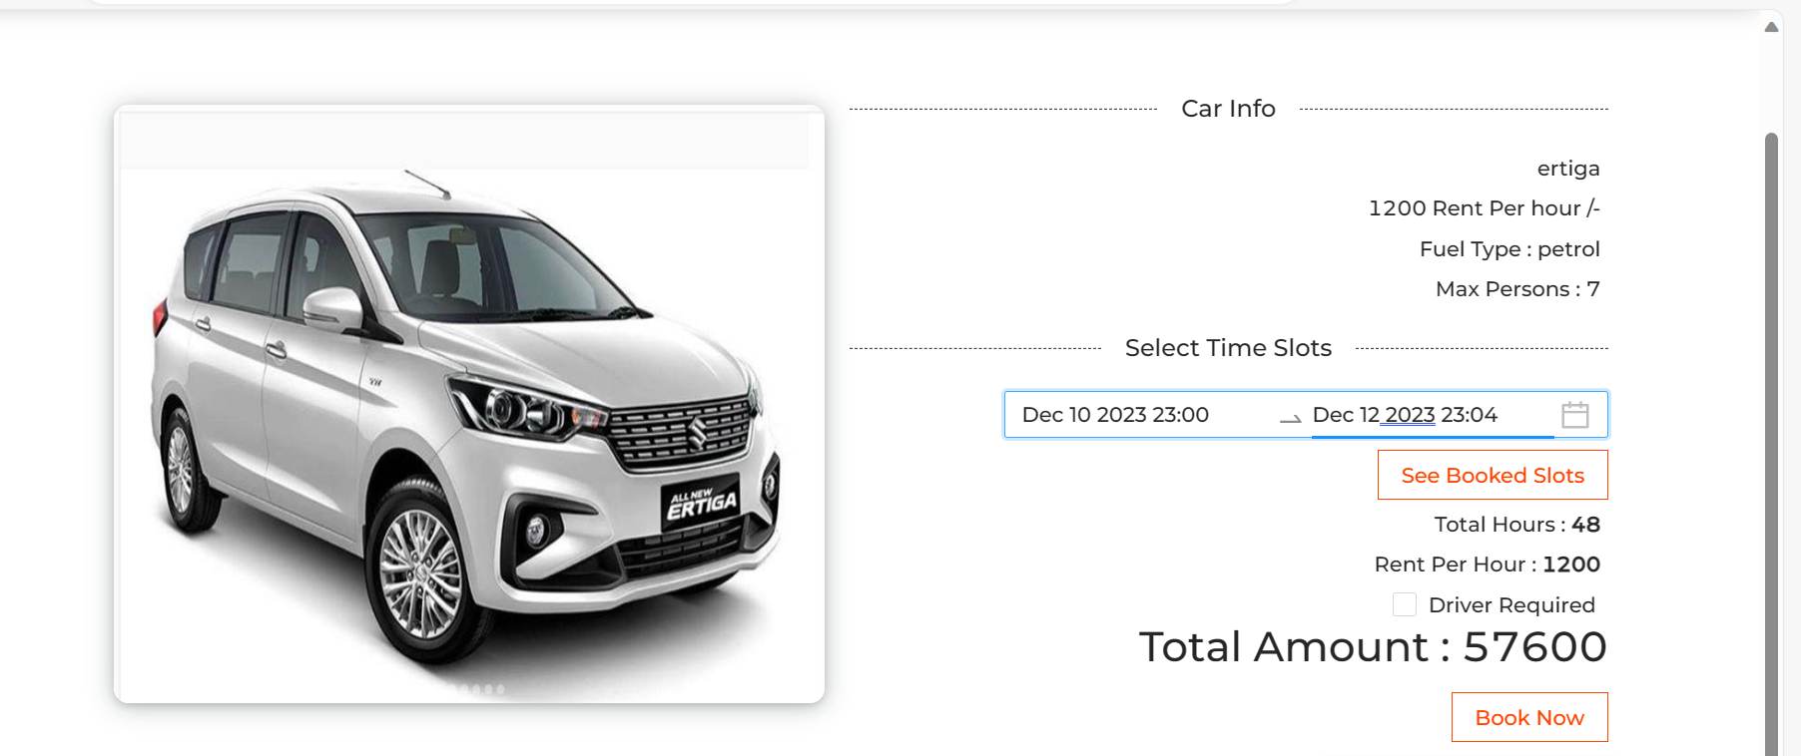
After selected date you can see details

Slide 44
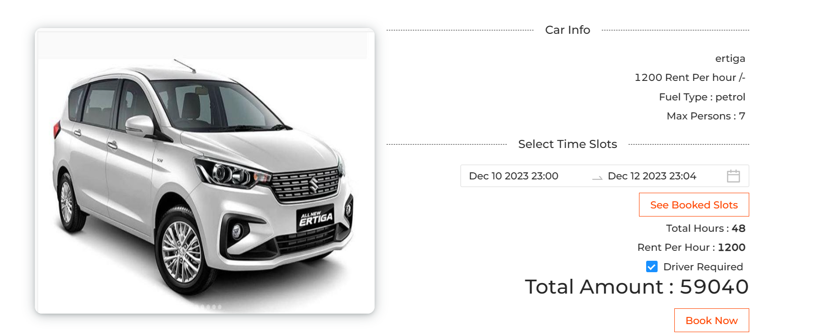
You can select the driver

Slide 45
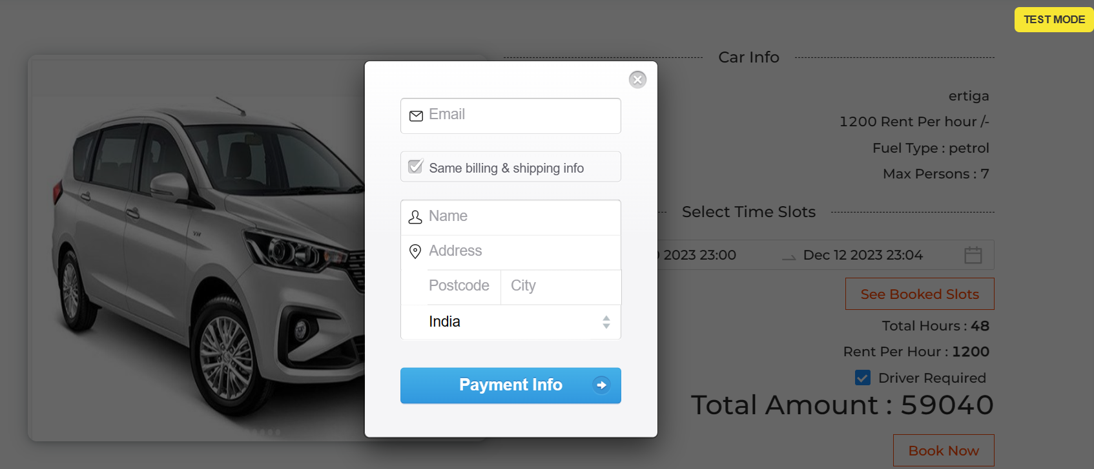
Once you click on book now it will open payment details page

Slide 46
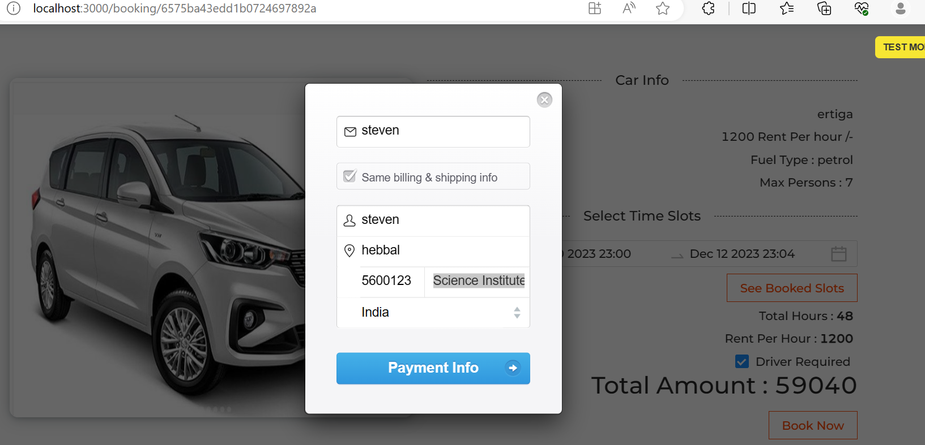
It will check information from live url

Slide 47
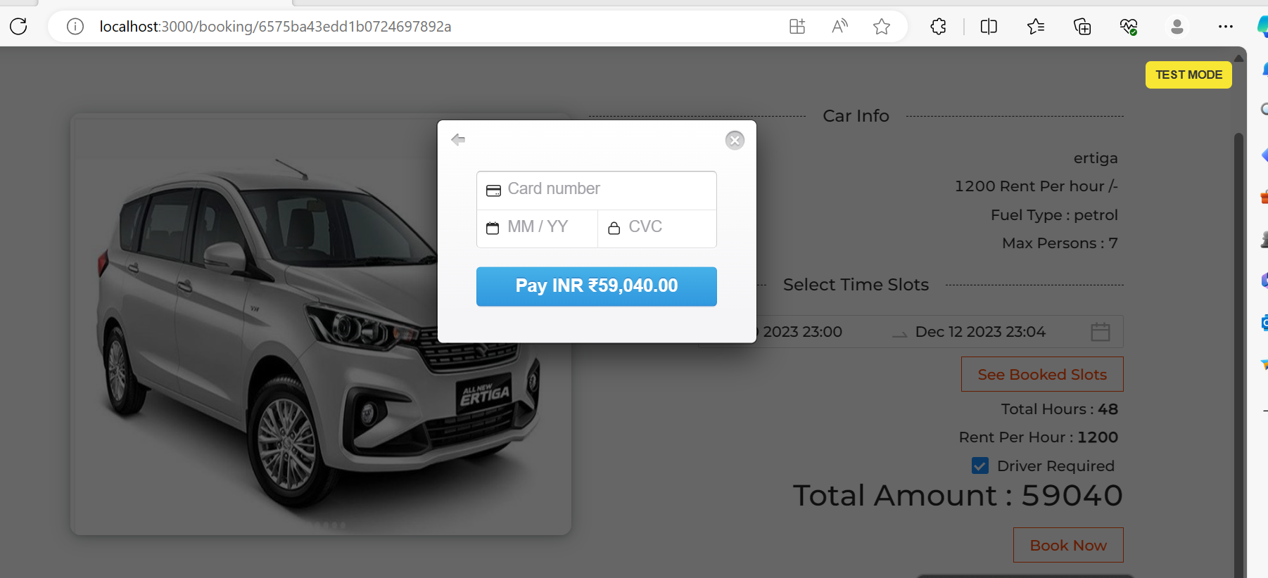
This payment is test mode

Slide 48
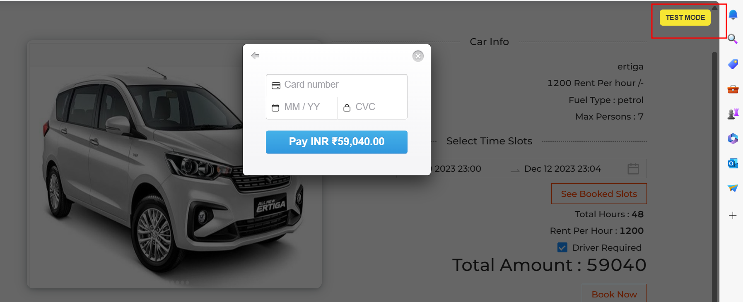
Please click on test model button

Slide 49
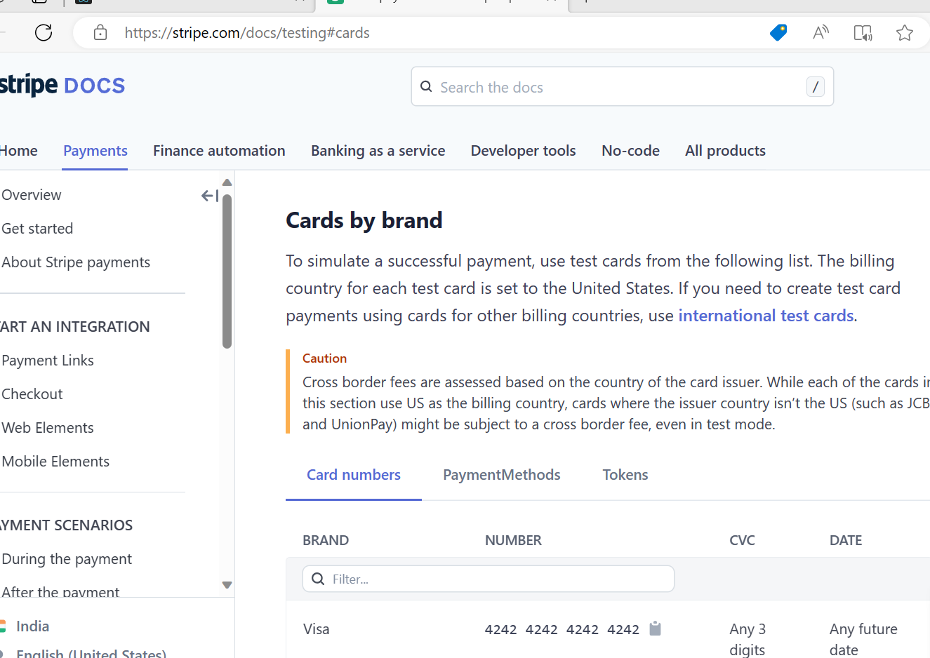
This is use stripe website

Slide 50
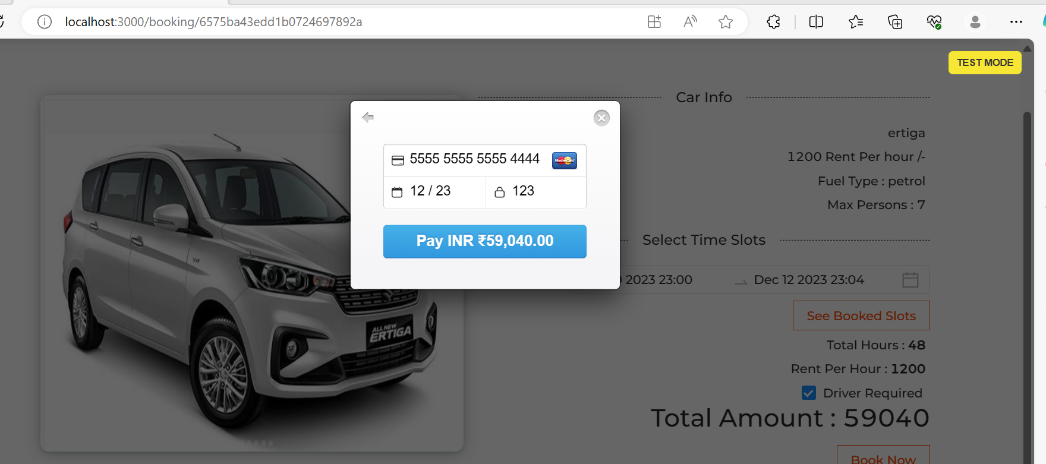
From this document you can get duppy card details to do the payment like a real time payment

Slide 51
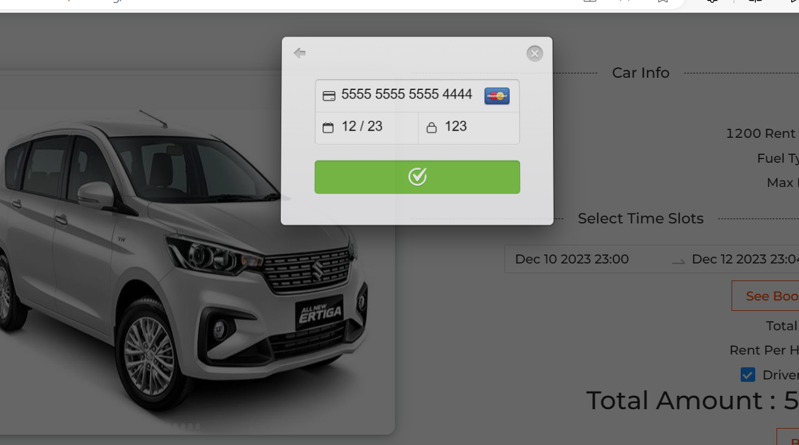
After click on payment

Slide 52
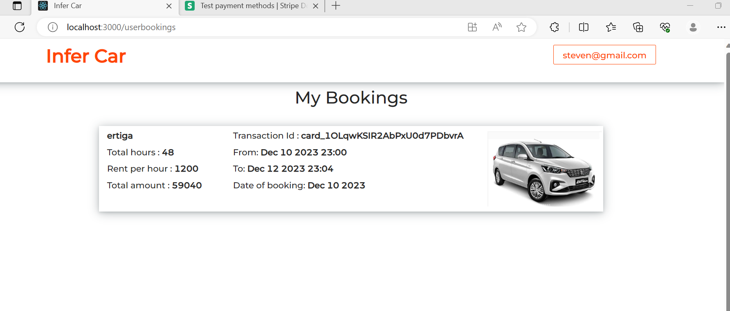
You can see the booking details

Slide 53
Adding Gen AI tool features to existing project

Slide 54
Phase 1 : AI-Assisted UI
Tools: Uizard

Slide 55
Step-by-Step: Upload React Login Page to Uizard and Enhance UI (Free Tier)
Capture Your React Component as an Image
You need a screenshot of your login component:
Open your app in the browser.
Press PrtSc or use Snipping Tool / Snip & Sketch to take a screenshot.
Save it as a .png or .jpg.

Slide 56
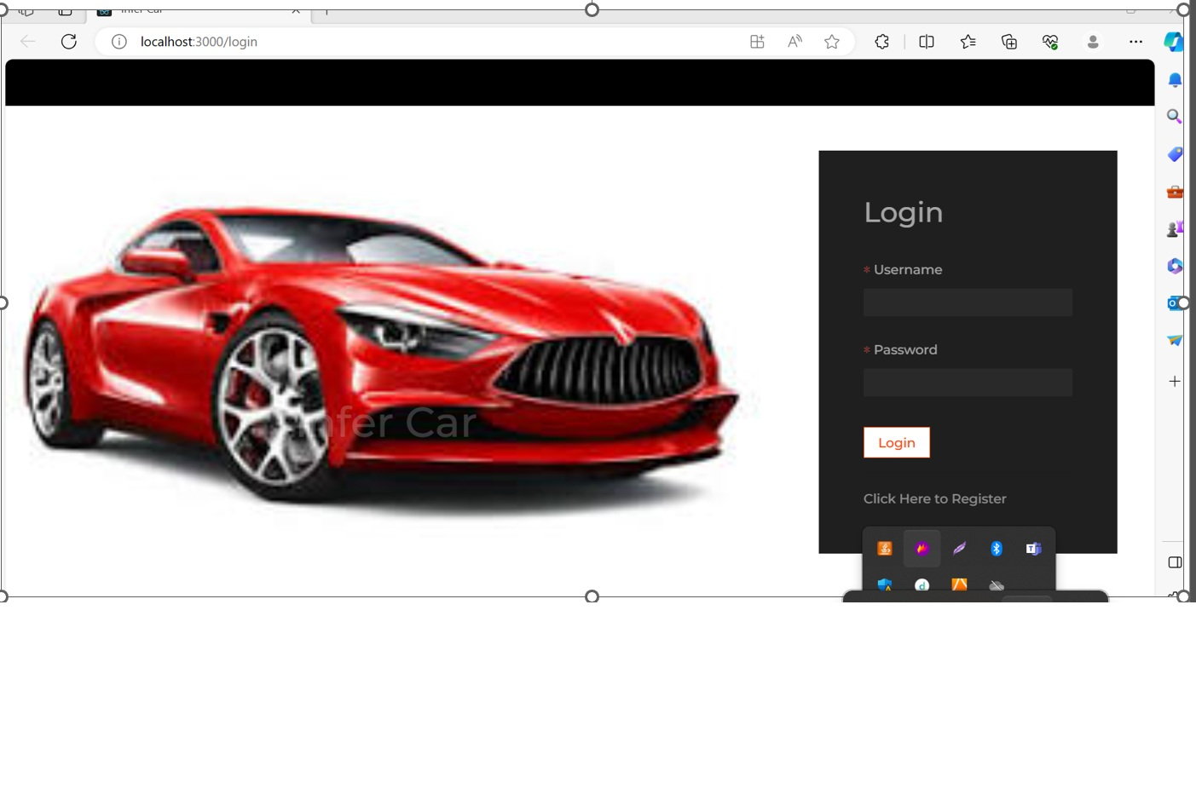
This is a screen short the login page of the React JS Application

Slide 57
Go to Uizard and Start a Project
Visit: https://uizard.io
Sign up or log in (free account)
Click on “Start from screen short”
Choose: Screen short scanner
Select “in prompt message select the desktop”
It will ask you to upload the image.

Slide 58
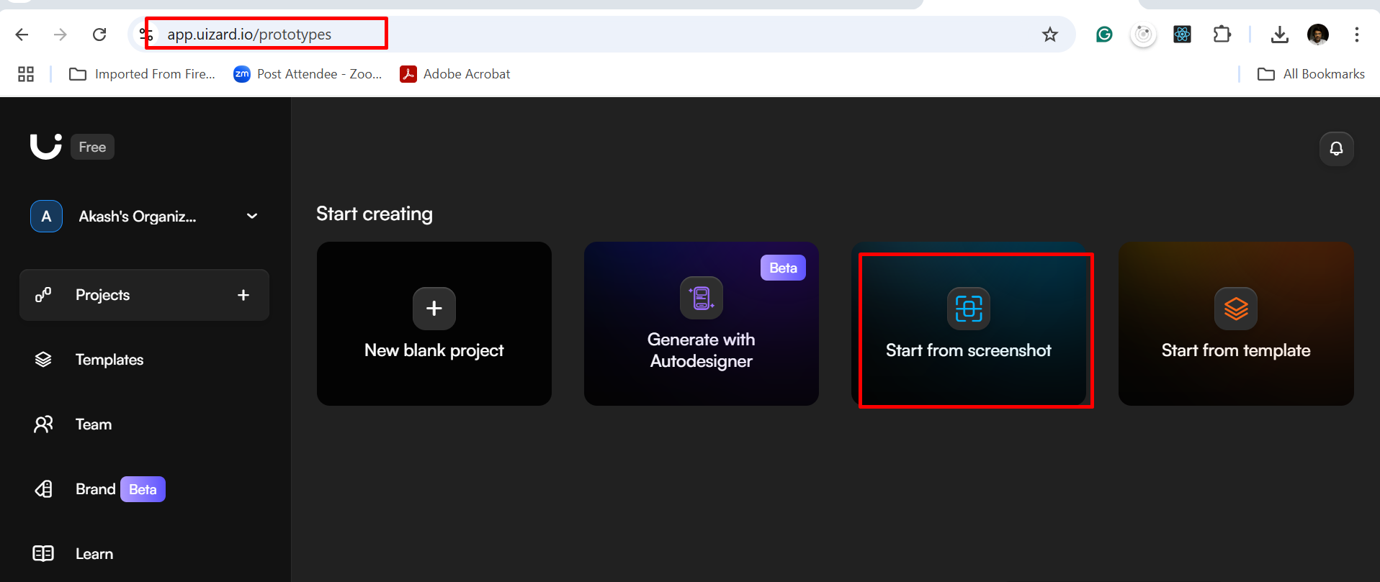
You need to login the Uizard dashboard after created login. Then in dashboard you need to select Start from screen short

Slide 59
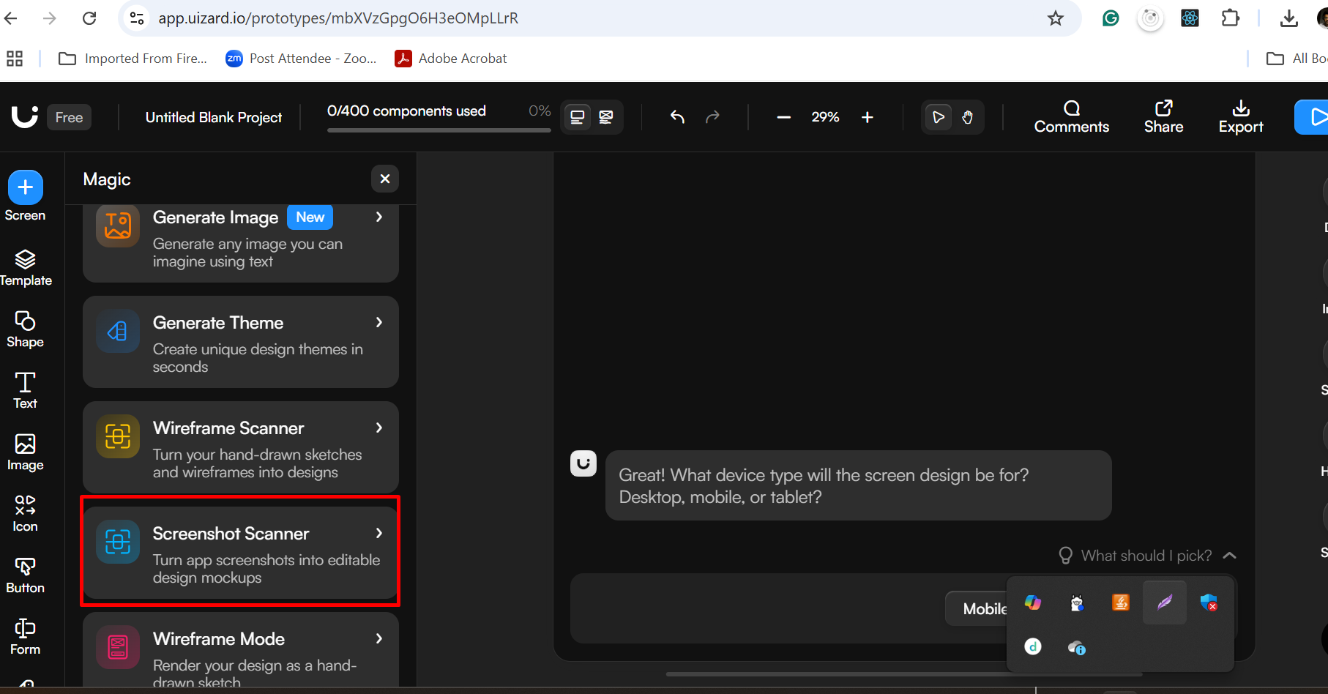
Here you need to click on Screen short scanner option

Slide 60
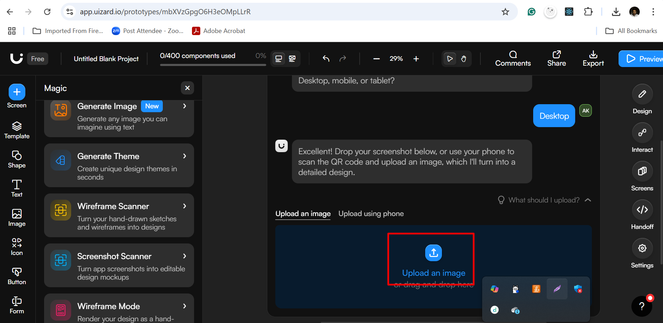
Here you need to select the option as Desktop application
Then it will ask you to upload the image.
So please provide the select the react js login page screen short

Slide 61
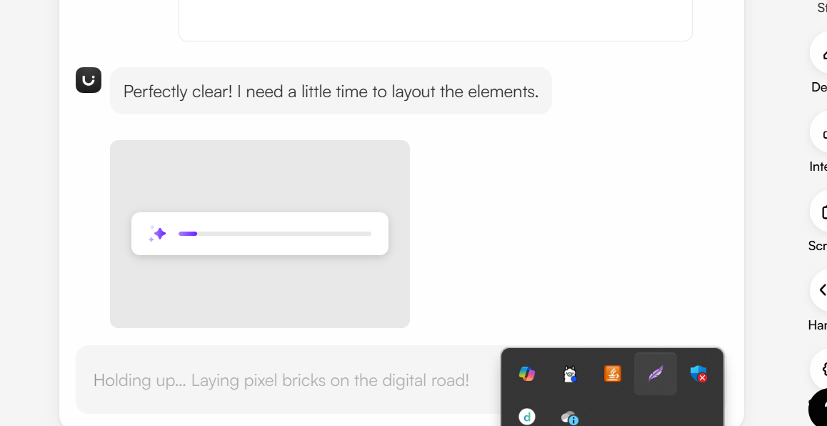
It will take some time to provide the help using AI assistance tool

Slide 62
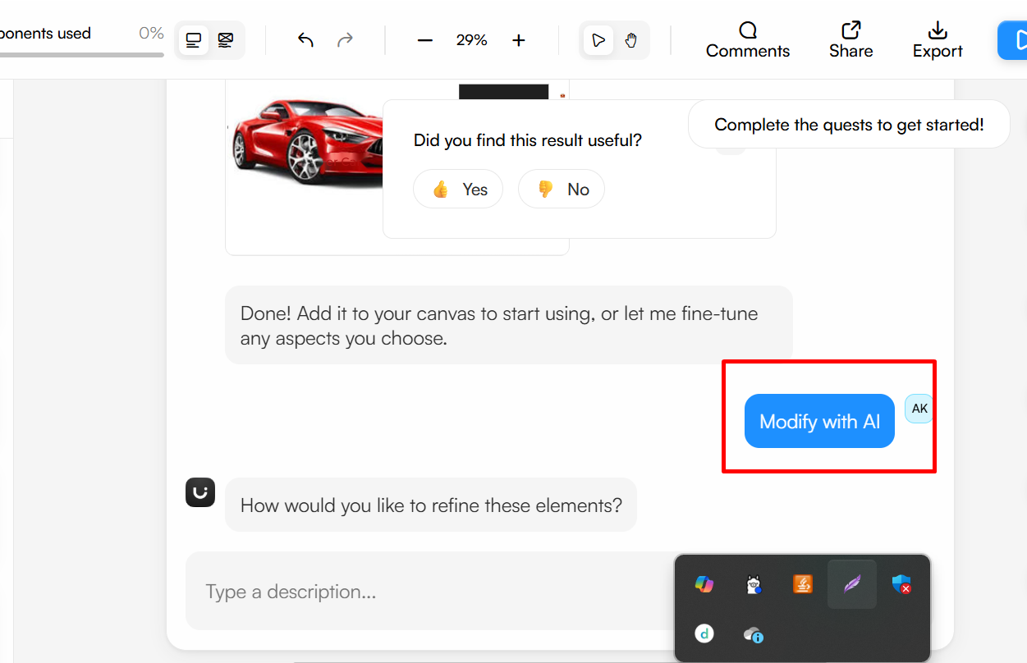
Now click on modify with AI tool option.
Which ask some question. Provide appropriate message.

Slide 63
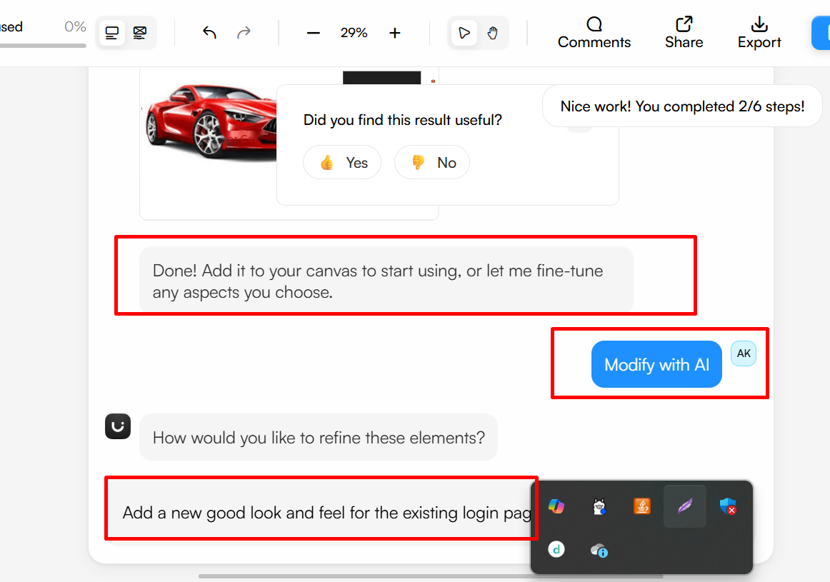
Here I have provided prompt message as “Add as new good look and feel for the existing login page”.
This is a sample prompt message. You can ask any meaning full prompt message.
But make sure you are using free tier login details. So you will not get all features.

Slide 64
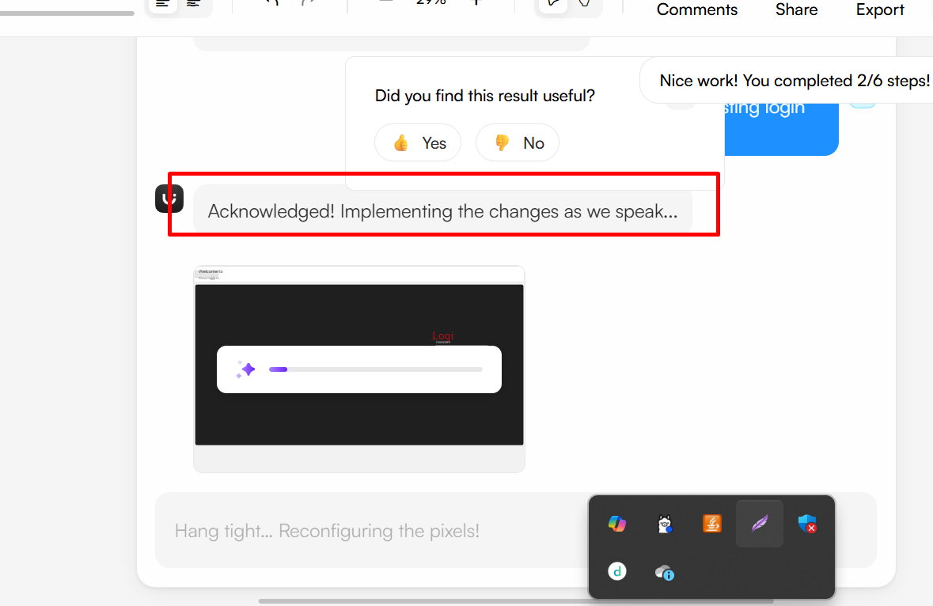
So here AI Assistance tool ready to generate the image base upon your requirements.

Slide 65
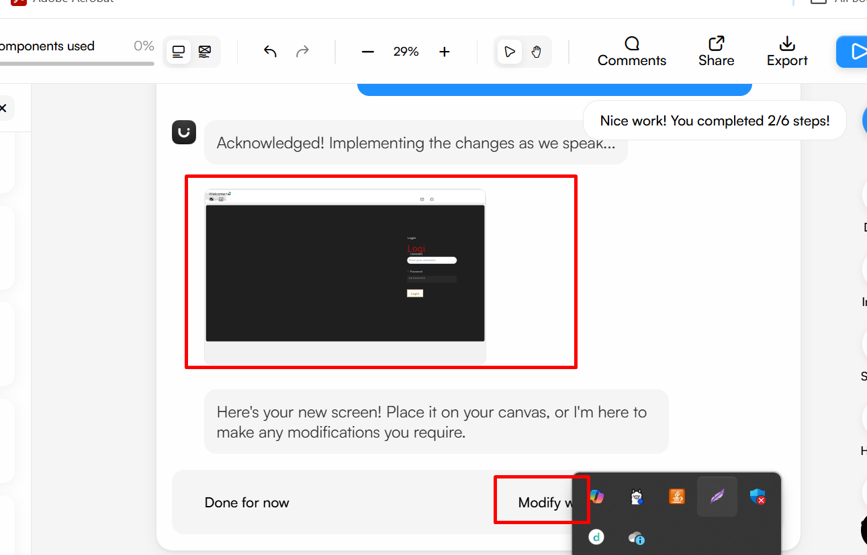
It generated Sample login page. The page look and feel can be different for you.

Slide 66
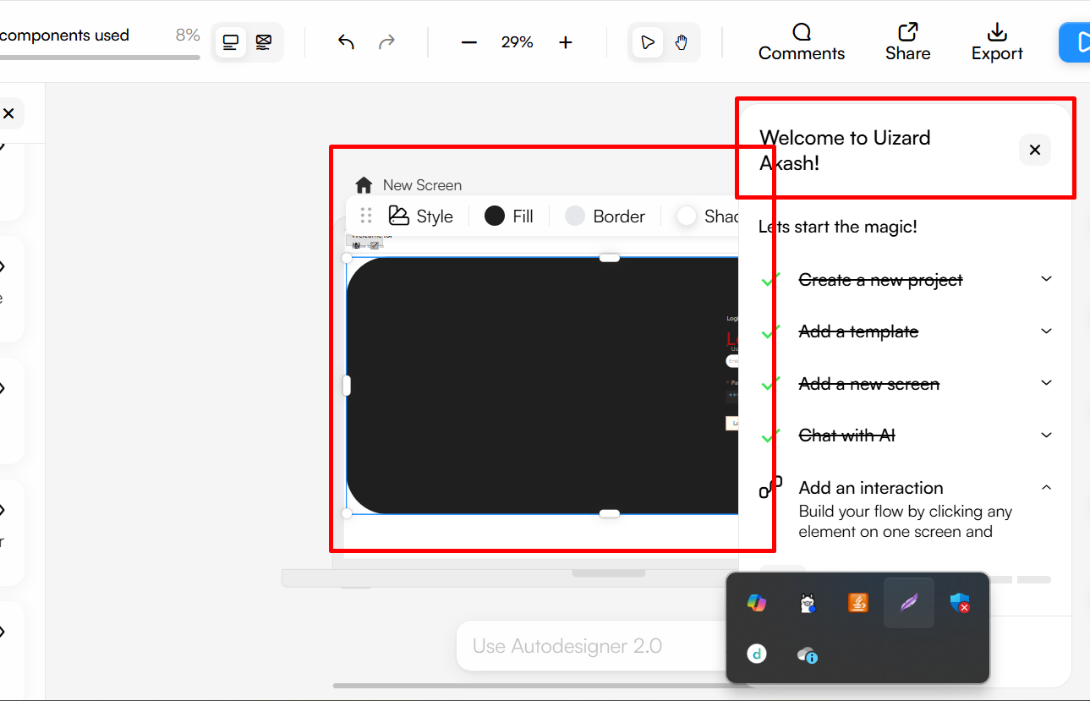
If you want to modify then you can select the screen and use the option to do the changes base upon your requriements.

Slide 67
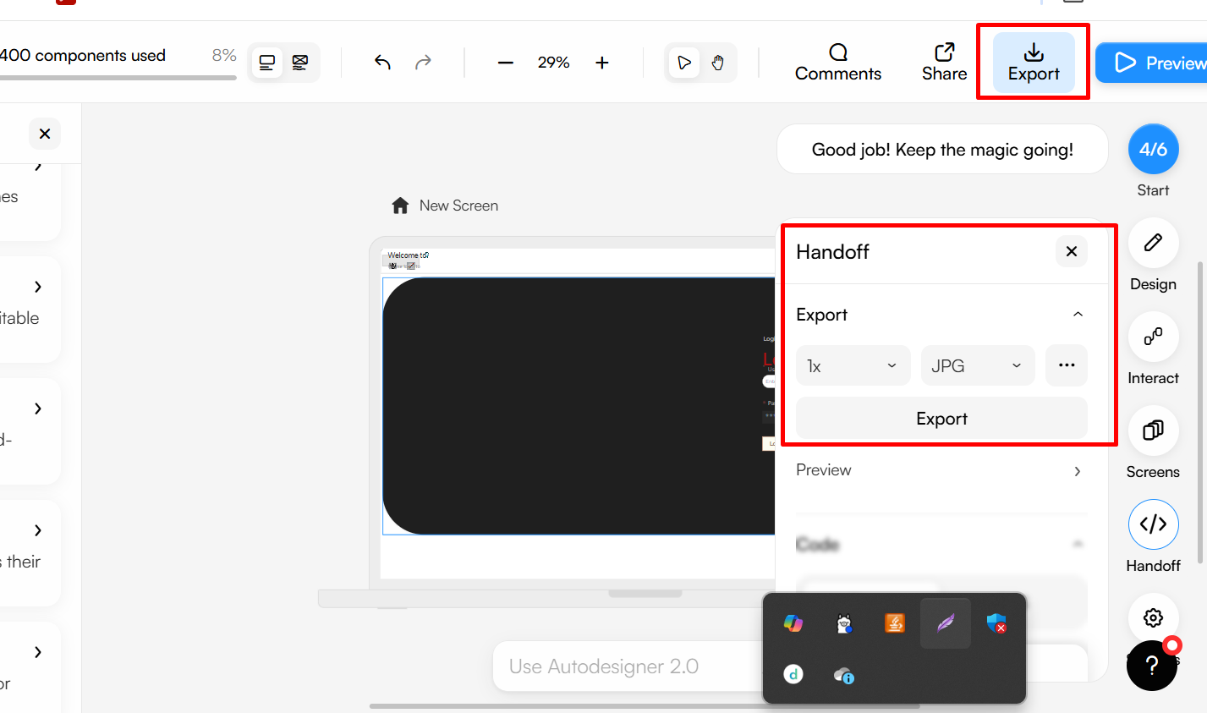
After that you can download the generate image.
Please select export option and format of the image.

Slide 68
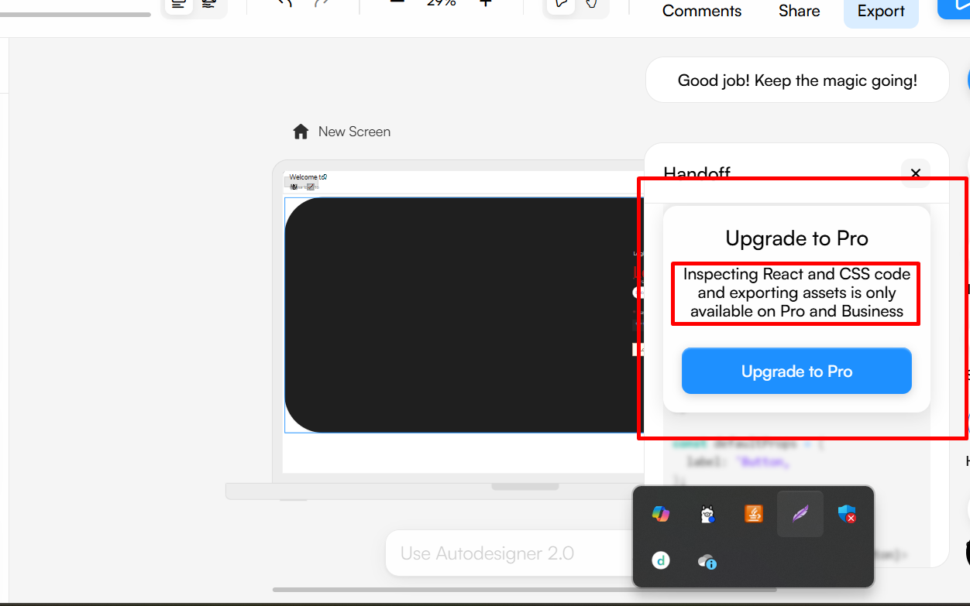
If you upgrade Uizard to Pro version.
It will allow to generate React JS Component with style as CSS

Slide 69
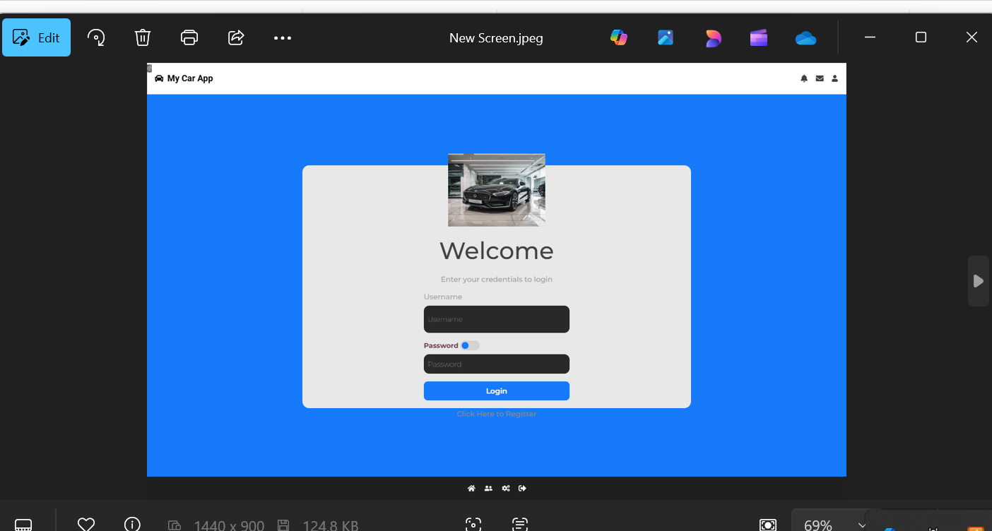
This is a sample login page generated with the help of Uizard AI design tool.

Slide 70
Phase 2 : AI-Assisted Development
Tools: GitHub Copilot, ChatGPT

Slide 71
Enable GitHub Copilot in VS Code.
Start typing your React components, routes, or backend service methods.
E.g., Type getCabAvailability = async () => → Copilot suggests logic automatically.

Slide 72
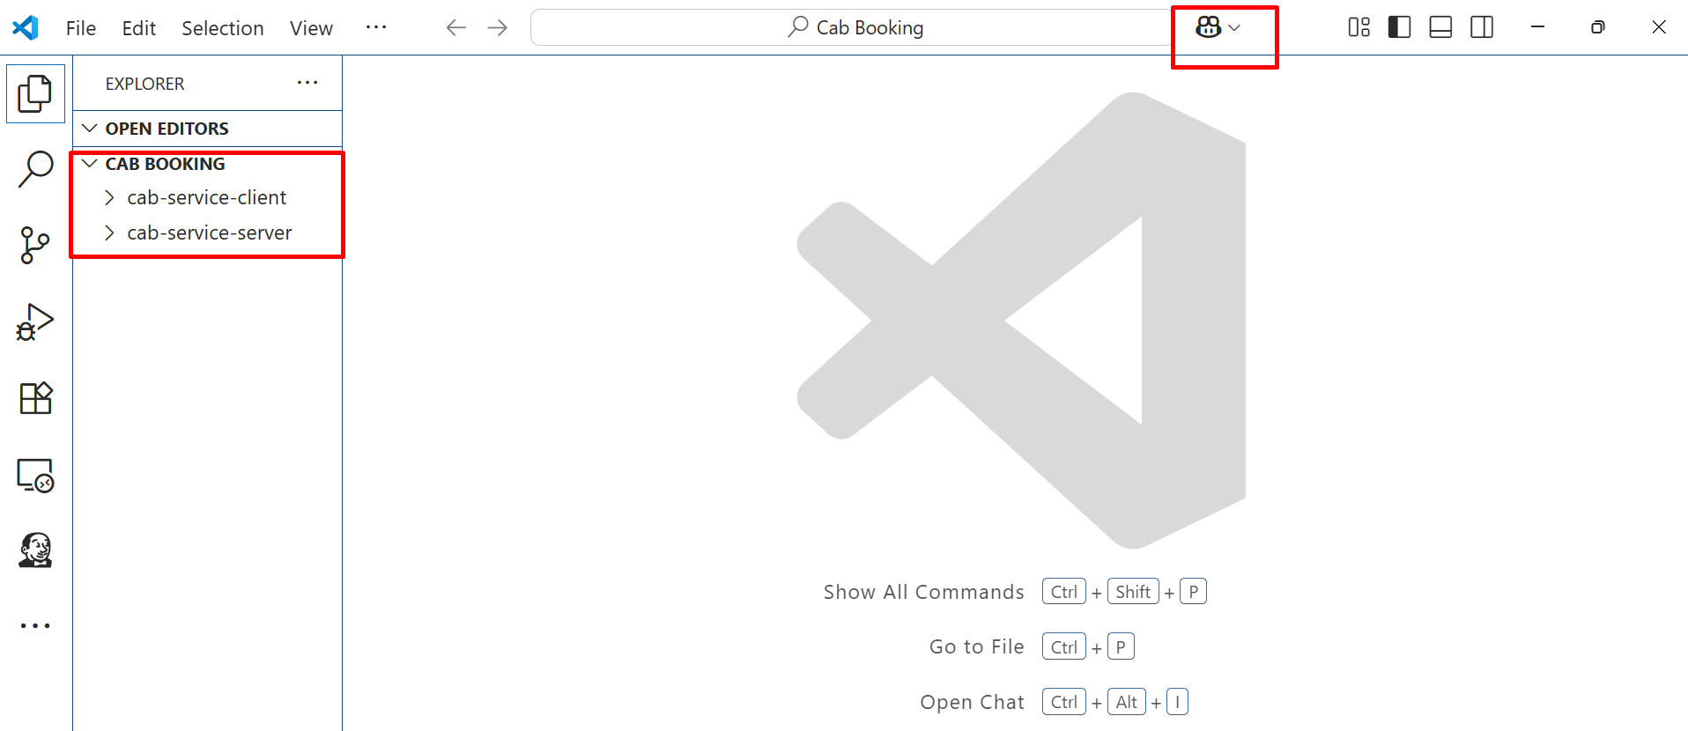
Open this project in VS Code

Slide 73

Open the GitHub Copilot option.
Ask Copilot to get code AI Assistance

Slide 74

Here Sample AI assistance prompt message.
/workspace and prompt message. Here sample prompt message base upon the requirements.

Slide 75

If it generate new code. You can ask new prompt message. @workspace with different prompt message

Slide 76

Here you can see sample generated code. Code can be different for you base upon your version as well as prompt message.

Slide 77

Be careful, you need to copy new generated code in respective file.

Slide 78

Sample code for carsRoute.js file

Slide 79

Here the sample code of carsActions.js file

Slide 80

Sample code for Home.js file

Slide 81

Summary of changes.
Code can different base upon prompt message as well as existing functionality code

Slide 82
Now run the application and test it
If you get any error.
You need to debug the code in backend technologies.
You need to re-run the both the application ie
Backend and frontend application once again.

Slide 83

Here if you are not able to see the change.
You can ask proper prompt message.

Slide 84
Now apply this code to Home.js file and test it.

Slide 85

Here Check Availability button with backend and frontend functionality generated using GitHub copilot AI tool

Slide 86
ChatGPT tools

Slide 87
Use ChatGPT prompts like
“Generate Mongoose schema for car booking with carId, userId, startDate, endDate.”
“React component for selecting a car and making a Stripe payment.”

Slide 88

Here open the ChatGPT and ask the prompt message in ChatGPT as below.
“Generate a Mongoose schema for car booking with cardid, userId, startDate and endDate”

Slide 89

Here is the sample code

Slide 90

Here is another example to take the Help of Chat GPT to generate the code for React JS.
“React component for selecting a card and making a Stripe payment”

Slide 91

Here are the instruction for the code.

Slide 92

All code with following step for the React JS Application

Slide 93


Slide 94


Slide 95


Slide 96
AI to optimize or rewrite existing logic of backend or frontend technologies

Slide 97

Here open the GitHub Copilot and ask the prompt message for calculate the price base upon some condition
Please follow high lighted prompt message to generate the code.

Slide 98

Follow the instruction and copy/paste the generated code in particular file.

Slide 99

Here created utils folder, which contains fareCalcuator.js file with generate code by GitHub copilot Ai tool

Slide 100

Here import this code or link this file to BookingRoute.js file

Slide 101

Sample BookingRoute.js file. Be care full. Copy/paste the generated code properly.

Slide 102
Re run the application. If you get any error. Please debug the application.
You can take the help of GitHub copilot.
According to generated code need to install one plugin as
npm install moment

Slide 103
Code Optimization & Documentation
Tools : GitHub Copilot and Chat GPT

Slide 104

Here open once again GitHub Copilot Prompt
Ask for GitHub Copilot as “What is the time complexity of my car booking route in express”

Slide 105

Here, You can see the time complexity for the existing code

Slide 106

Summary for the Time complexity

Slide 107

Here you can optimize the mongoose query. Sample prompt message to optimize the mongoose database query

Slide 108

Sample code generated base upon the prompt message

Slide 109

Explanation of the optimization of the code

Slide 110
Phase 4: AI-Powered Testing
Tools: TestRigor

Slide 111
TestRigor
Connect your app URL to TestRigor.

Slide 112
Login for Test rigor
Step 1: Sign Up & Log In
Go to https://testrigor.com.
Click “Try it free” or “Sign Up”.
Provide your email address and create a password (or use Google account).
Confirm your email if prompted.

Slide 113

Open the browser with below URL as http://testrigor.com. You can see below web site.

Slide 114

If you don’t have account. Please create the account.

Slide 115

After created account you can create the Testing Suite.

Slide 116

While creating Test suite below Sample data. You can provide your proper information base upon your requirements.

Slide 117


Slide 118


Slide 119

It generated sample test cases.

Slide 120

Sample below Test case details in dashboard

Slide 121
Now we will create test case

Slide 122

Select the test case option.
Then add the test case.

Slide 123

Here you need to write the test case in English statement.
You can take the help of generate sample test using AI

Slide 124
Test natural language
The below Sample natural language test case steps
go to "http://localhost:300"
enter "testuser" into "steven@gmail.com"
enter "password123" into "steven@123"
click "Login"
click "Book a Cab"
enter "Mumbai" into "Pickup Location"
enter "Pune" into "Drop Location"
click "Search"
click "Select" on the first car
click "Proceed to Payment"
enter card number "4242 4242 4242 4242"
enter expiry "12/28"
enter CVV "123"
click "Pay"
check that page contains "Booking Confirmed"

Slide 125

Here we will get the error. Because our application running locally. If run on cloud or develop then we can test very easily

Slide 126

You can generate sample test case

Slide 127

Now click on actual test generate by AI

